Slide 1
Deep convolutional neural networks for accurate somatic mutation detection
Bohao.Zou

Slide 2
Somatic Mutation Tools (Statistical And Algorithmic Approaches)
MuTect2
MuSE
VarDict
VarScan2
Strelka2
SomaticSniper (The Best in Normal Tools)
The defect of normal tools:
They are limited in generalization to a broader range of sample types and sequencing technologies and thus may exhibit suboptimal accuracy in such scenarios.
The best performance in those tools is SomaticSniper . it uses the machine-learning technology and do well in some cases . However it also has drawback , such as in the low complexity regions and low tumor purity sample , the result of SomaticSniper is not well .

Slide 3
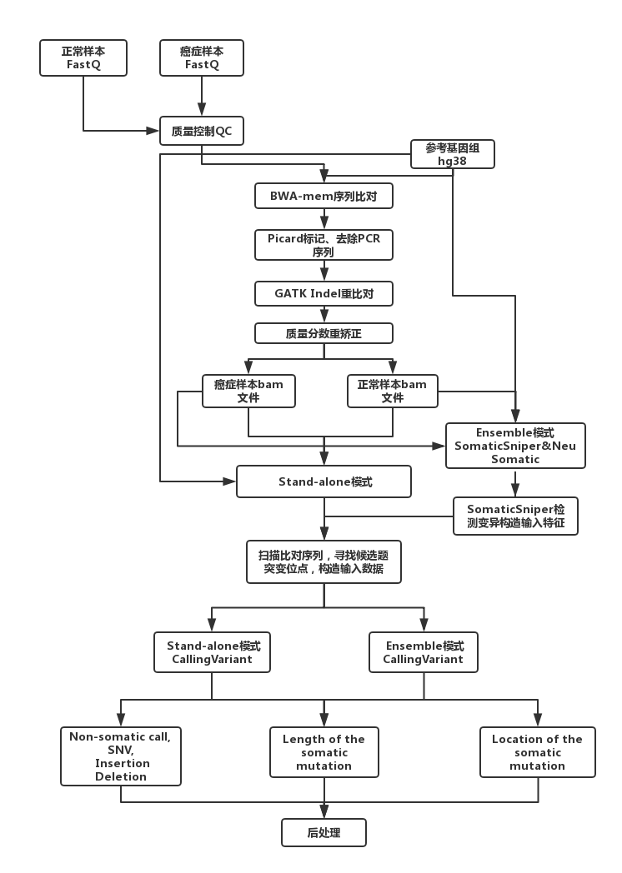
Candidate Mutation Preparation
As the first step, we scan tumor read alignments to find candidate locations with evidence of mutations,Many of these positions have either germline variants or erroneous calls made due to the complexity of the genomic region .
We apply a set of liberal filters on the set of candidate locations to make sure the number of such locations is reasonable.
Stand-alone model:
For SNVs, we required AF (allele-frequency) ≥ 0.03 OR more than 2 reads supporting the SNV and Phred scaled base quality score larger than 19 (larger than 14 for real WES dataset) as the minimum requirements.
For 1-base INDELs, we required AF≥ 0.02 or more than one read support.
For INDELs larger than 1-base, we require AF≥ 0.03 .
Ensemble model:
Used AF ≥ 0.1 for SNVs and INDELs larger than 1-base.
AF ≥ 0.15 for 1-base INDELs.
NeuSomatic (Work Flow)

Slide 4
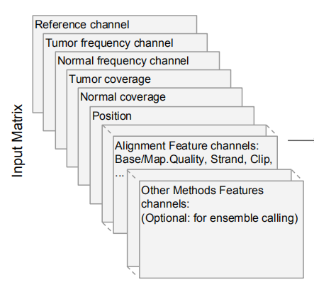
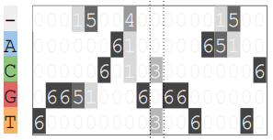
NeuSomatic (Input General)
Input Candidates :
The inputs to NeuSomatic's network are candidate somatic mutations identified by scanning the sequence alignments for the tumor sample as well as the matched normal sample .
Somatic mutations reported by other methods can also be included in this list of candidates.
Input Structure:
They construct a 3-dimensional feature matrix M (of size k × 5 × 32), consisting of k channels each of size 5 × 32, to capture signals from the region centered around that locus .
Each channel of the matrix M has 5 rows representing the 4 nucleotide bases as well as the gapped base (‘-’), and 32 columns representing the alignment columns around the candidate location.

Slide 5
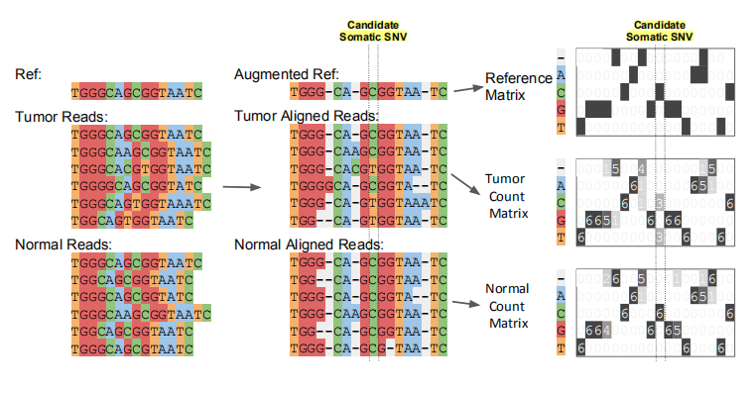
NeuSomatic (Input Detail)
Sequence alignment information in a window of 7 bases around the candidate somatic mutation is extracted.
Reference channel:
The reference sequence is then augmented by adding gaps to account for insertions in the reads.
The augmented alignment is then summarized into the reference matrix.
The tumor and the normal count channel :
The count matrices record the number of A/C/G/T and gap (‘-’) characters in each column of the alignment .
Coverage channel:
The count matrices are then normalized by coverage to reflect base frequencies in each column
Another channel:
Record other alignment signals in tumor and normal samples, such as base quality, mapping quality, strands, clipping information, edit distance, alignment score, and paired-end information.

Slide 6
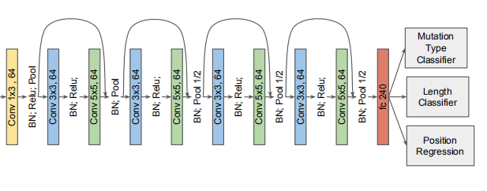
NeuSomatic (CNN Architecture And Output)
Three classifications output:
The first classifier identifies whether the candidate is a non-somatic call, SNV, insertion, or deletion .(softmax classifiers,Cross entropy loss function)
The second classifier predicts the length of the somatic mutation with four classes (0 indicating non-somatic, or lengths from 1, 2 or greater than 2) (softmax classifiers,Cross entropy loss function)
The third regressor predicts the location of the somatic mutation.regressor predicts the column of the mutations in the matrix .(smooth L1 loss function)
Post Processing :
If the lengths of INDELs are predicted to be larger than 2, we perform a simple post processing step on reads overlapping that position to resolve the INDEL sequence from the read alignment CIGAR string.
For higher error rate sequencing data, more complex local realignment post-processing is conducted to resolve the INDEL sequence.

Slide 7
NeuSomatic（CNN Training）
Noraml Training tactics:
We trained the network using a batch size of 1000 with SGD optimizer with learning rate of 0.01, and momentum of 0.9, and we multiplied the learning rate by 0.1 every 400 epochs.
We use all the true somatic mutations in the training set and randomly selected non-somatic candidates with twice the number of the true somatic mutations. We used a weighted softmax classification loss function , to balance for the number of candidates in each category.
Training on multiple purities:
For more generalizable training, we combine the generated training input matrices from different tumor purities in the DREAM Stage 3 dataset, and used the combined set for training the network.
We then applied the trained model on each of the individual purities.

Slide 8
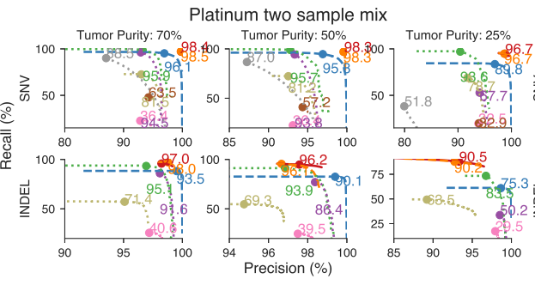
NeuSomatic (Evaluation-Platinum Synthetic Tumor Data)
Platinum synthetic tumor data:
Downloaded 200× Platinum genomes NA12878 and NA12877 and their truth germline variants to construct a virtual tumor and normal pair.
For tumor, we constructed three 50× in silico(电脑模拟) mixture samples with 70%, 50%, and 25% tumor purities, by independently downsampling NA12877 respectively at 15×, 25×, and 37.5×, and mixing each with downsampled NA12878 at 35×, 25×, and 12.5×.
For the normal, we downsampled NA12877 to 50× ，We then constructed an impure normal by mixing 95% normal and 5% tumor reads.
We use the heterozygous and homozygous variants in NA12878 which are reference calls in NA12877 and are at least 5 bases apart from each other as the truth set for the training and evaluation steps .(1,103,285 SNVs and 174,754 INDELs).

Slide 9
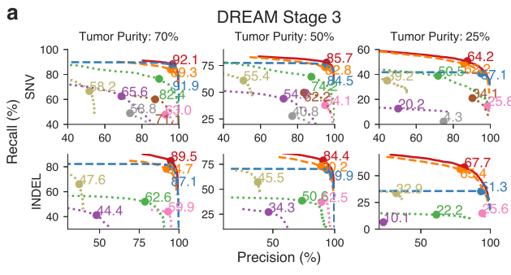
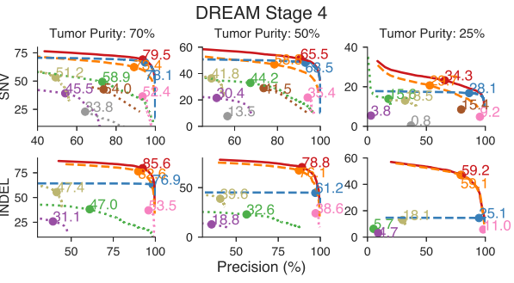
NeuSomatic (Evaluation-Others data sets)

Slide 10
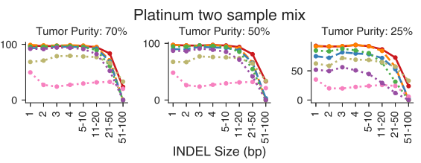
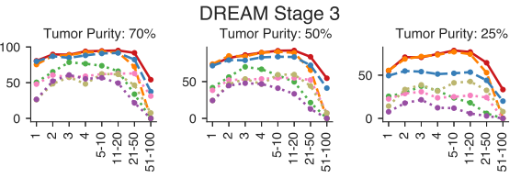
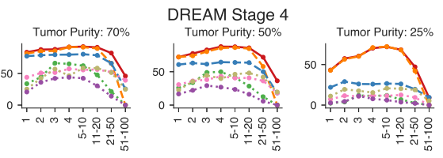
NeuSomatic (Evaluation-Why has low F1-Score with INDEL longer than 50 bp .)
Performance analysis of INDEL accuracy (F1-score) for different INDEL sizes
F1-SCORE
For large (> 50 bases) INDELs, since most of the short reads with somatic INDELs are soft-clipped, the INDEL information is lost in the pileup count matrices.
For such cases, NeuSomatic benefited from other methods’ predictions, since some of the methods like VarDict and MuTect2 used local assembly for their predictions.
F1-SCORE
F1-SCORE

